Slide 1

Skittles Q & A

Slide 2
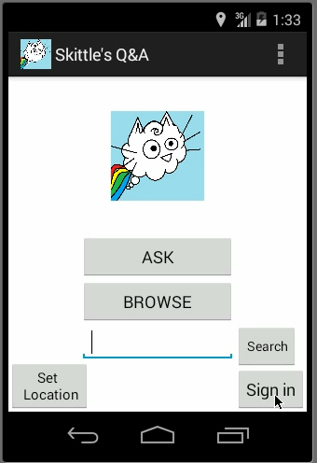
Sign In and Set Location

Slide 3
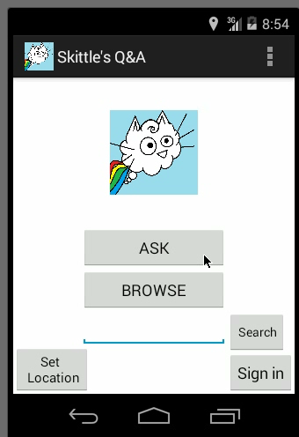
Asking Questions

Slide 4
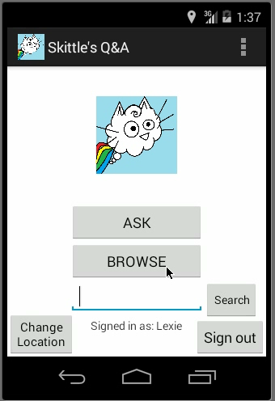
Answering Questions

Slide 5
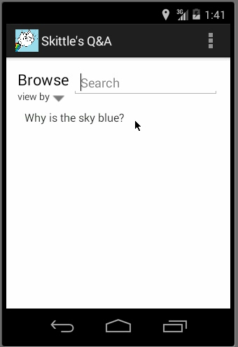
Replying To Questions and UpVoting

Slide 6
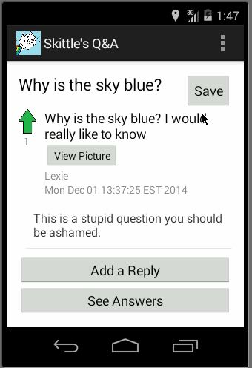
Adding To Read-Laters

Slide 7
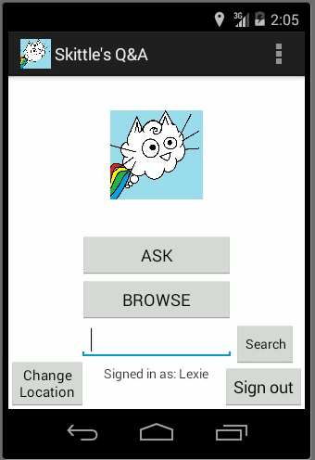
Search For Questions/Answers

